Slide 1


E-COMMERCE SYSTEM DESIGN

Slide 2
CAREPAY DAWA E-COMMERCE
Dawa.com allows people to order prescription drugs.
There is a shopping cart.
Our website is having hundreds of users at the same time.
We need to maintain horizontal scalability and keep our application available and reliable as possible.

Slide 3
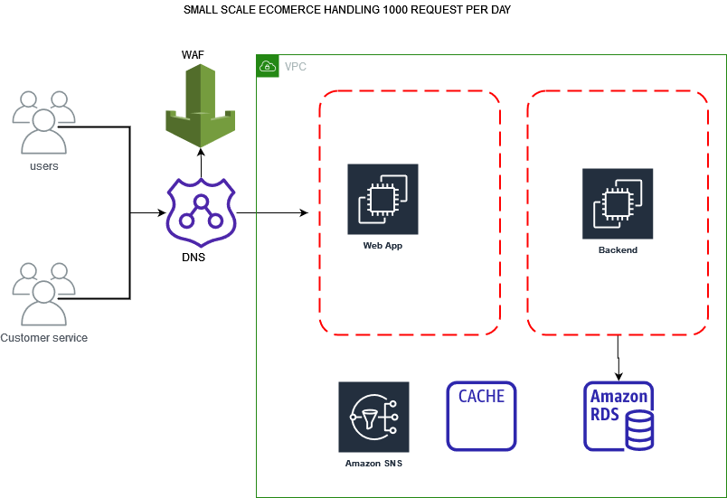
1000 REQUEST TO DAWA.COM

Slide 4
DIAGRAM ONE DISCUSSION
Features
Our e-commerce is on the early stages with little customer awareness.
Request per day are 1000 maximum.
Our engineers have designed a simple aws architecture to handle the few customers.
Route 53 is the DNS used, it is highly available and scalable domain name system.
WAF is web application firewall to protect our web application against common web exploits and bots.
VPC enables us to launch AWS resources into a virtual network that we have defined.

Slide 5
Diagram one discussion continuation
Features
Security group will help us create Inbound rules and outbound rules into our EC2 instances.

Slide 6
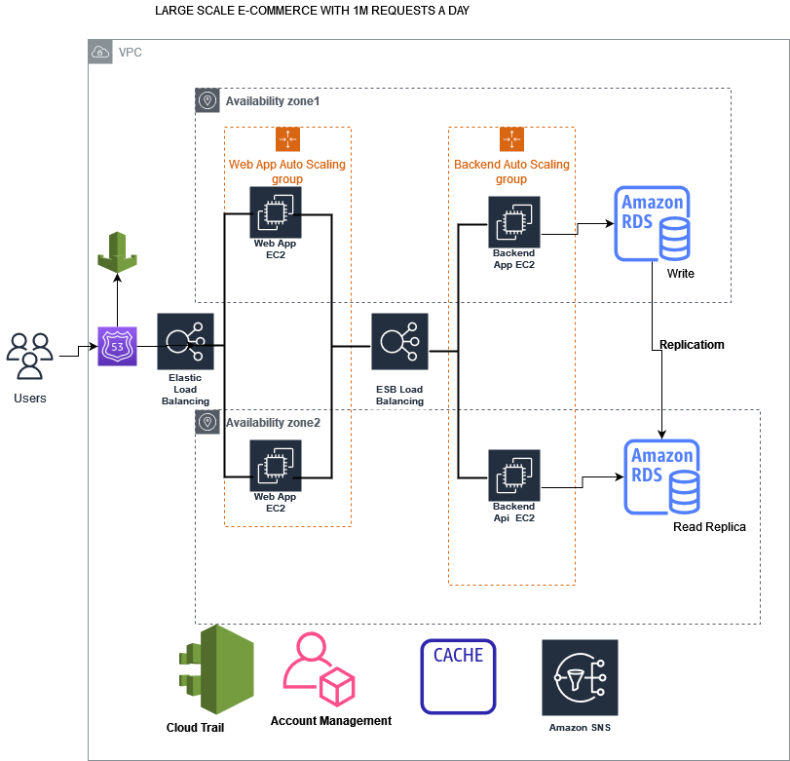
DIAGRAM 2.OVER 1 MILLION REQUEST PER DAY

Slide 7
DIAGRAM 2 DISCUSSION
Our Dawa.com business has grown tremendously.
There is need to scale and expand horizontally.
Our engineers has designed a new architecture that is highly available, scalable and cost effective.
Guided by the pillars of a well architected framework.
The have added the following:
Elastic load balancer for automatically distributing incoming application traffic and scales resources to meet traffic demands.
Auto-scaling groups to enable our application to scale up or down automatically according to your defined criterion
Write and read replicas to provide enhanced performance and durability for RDS database (DB) instances.

Slide 8
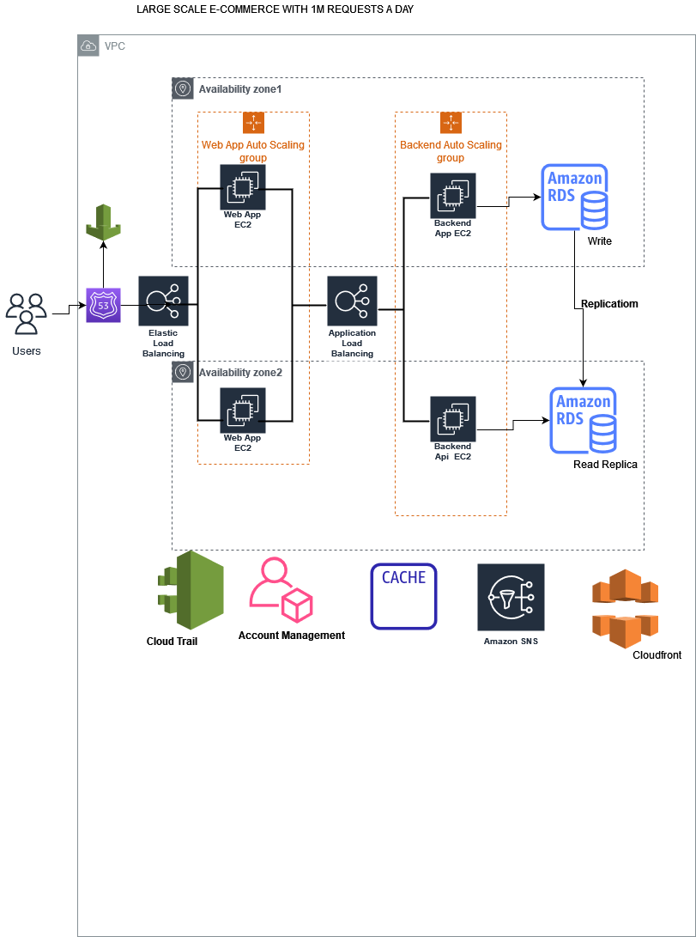
DIAGRAM 3:HIGH AVAILABILITY

Slide 9
DIAGRAM 3 DISCUSSION
High Availability is enhanced by following service:
Multi AZ RDS.
Multi AZ EC2.
Elastic load balance
Auto-scaling groups
Cloud front for high speed access of content

